Slide 1
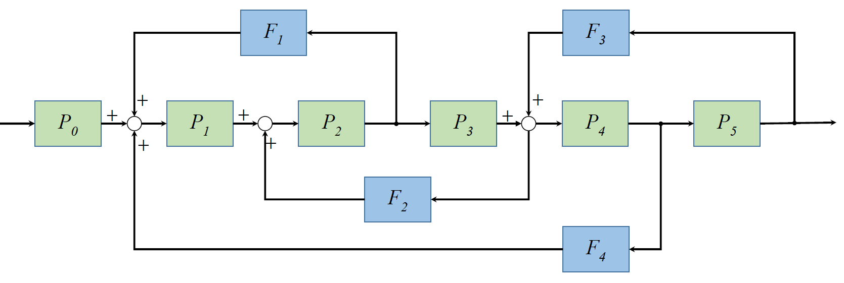
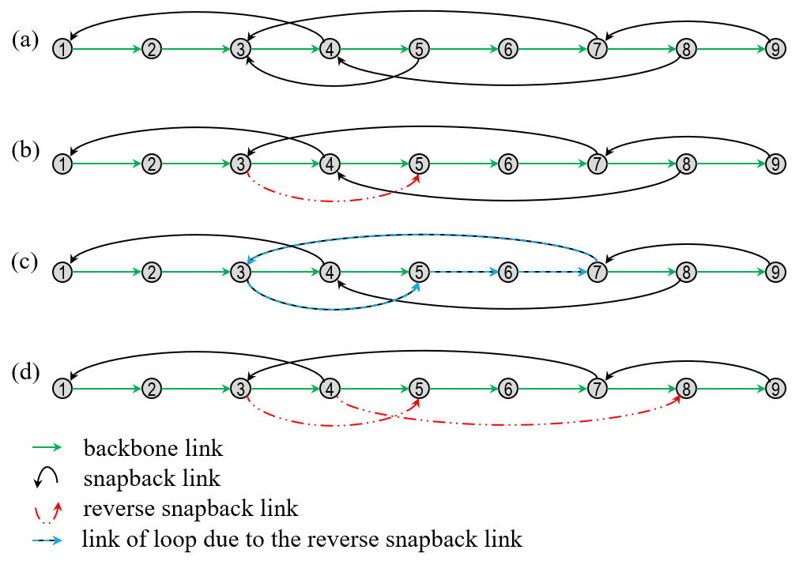
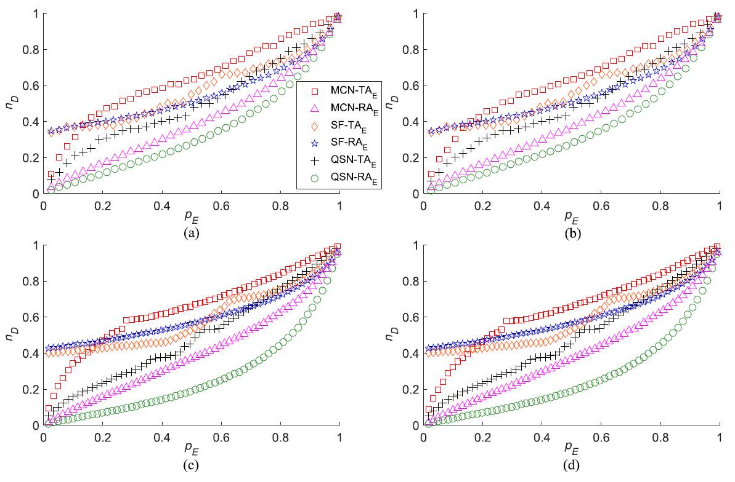
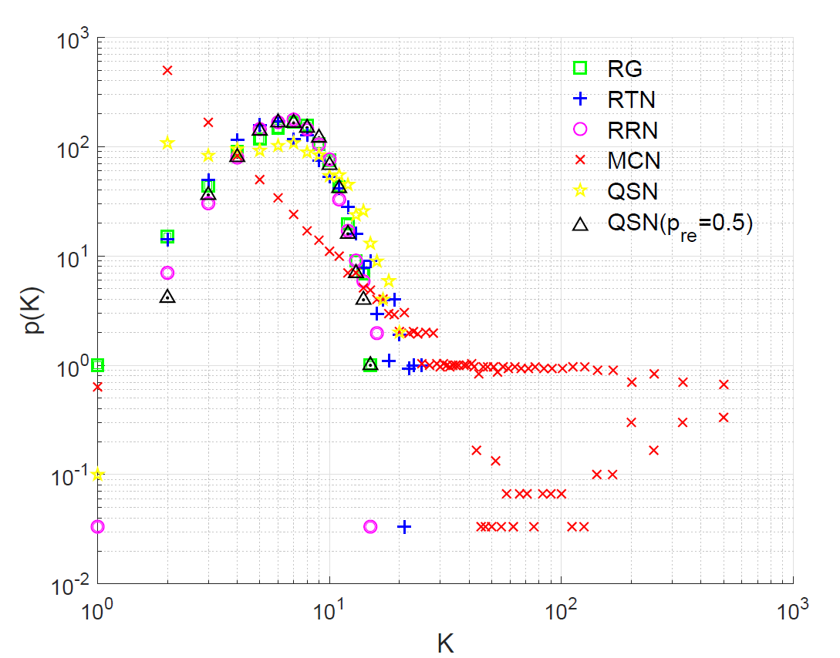
QSN and QSN with redirected edges
Assembly Line
Resembling to the industrial assembly-line automation, the q-snapback network (QSN) is established based on a backbone chain, with snapback edges determined by a probability 𝑞 ∈ (0, 1).
QSN and its variants show excellent controllability robustness against malicious node- and edge-removal attacks.
Degree Distributions

Slide 2
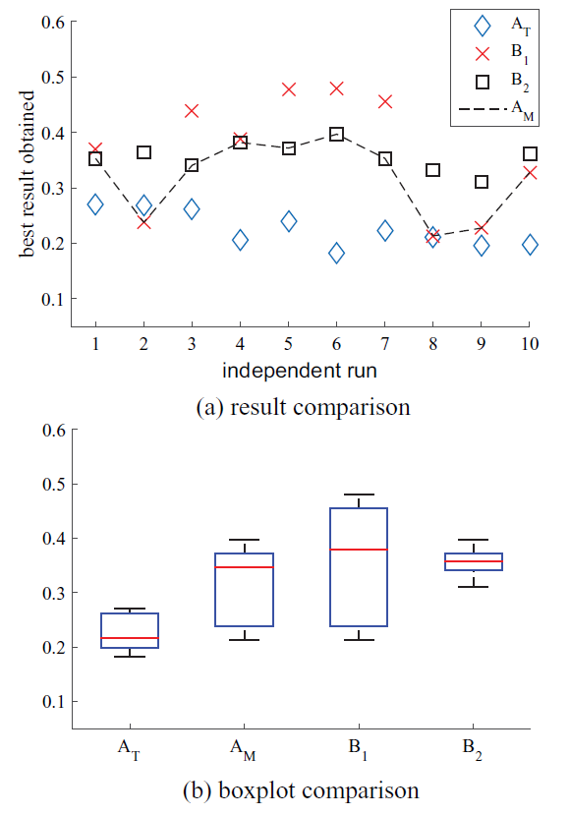
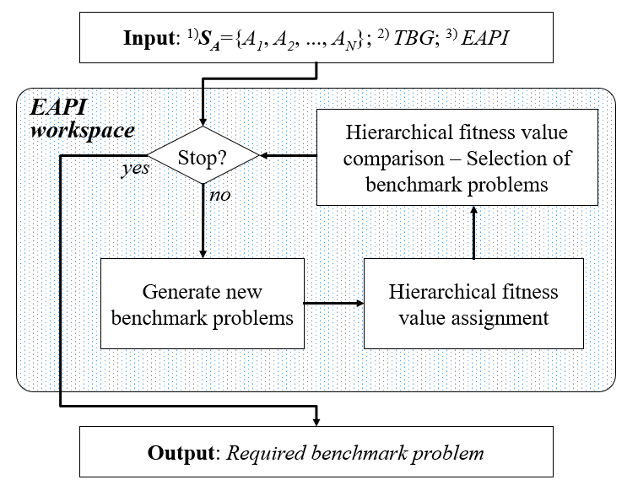
Hierarchical-Fitness-based Evolving Benchmark Generator

Slide 3
